Slide 1

How to choose the best spot to open a food business in London by exploiting the potential of the location and minimizing the impact of competitors
Applied Data Science Capston
IBM

Slide 2

This project aim is to analyse in which part of the big city of London it will be convenient for entrepreneurs open a particular food business in such a way to minimize the impact of competitors and maximize the potential of a location

Slide 3
Drivers for the analysis
No competitors in the same field
Few Competitors
Good location
Perfect spot
variables for success
Parking availability
Underground stops
Tourist sites

Slide 4
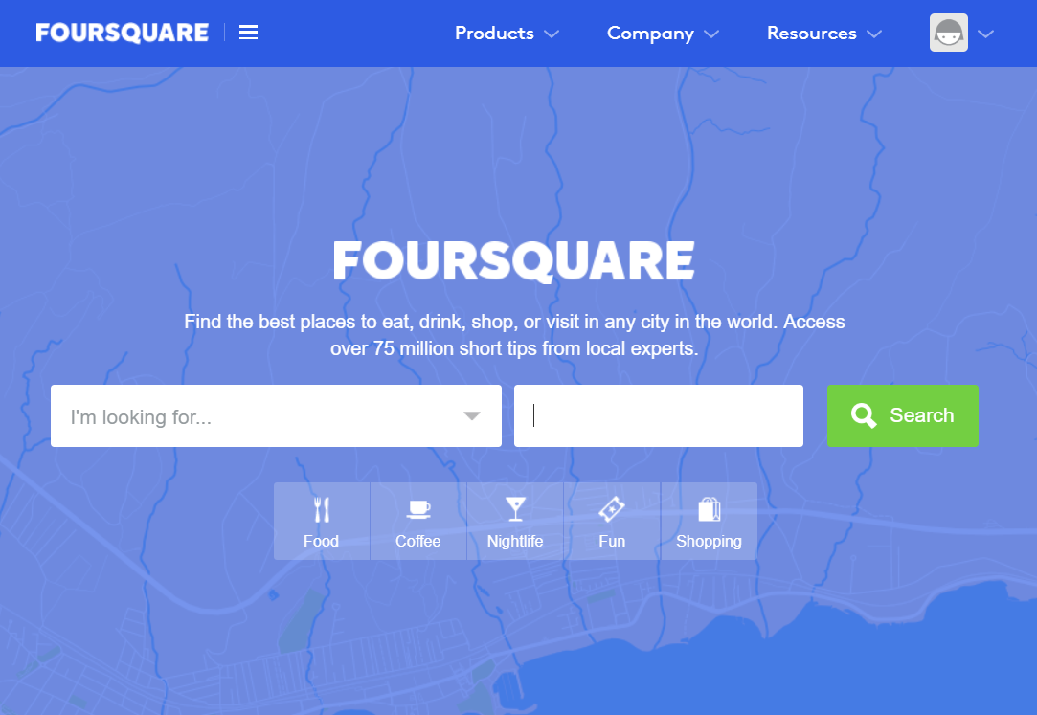
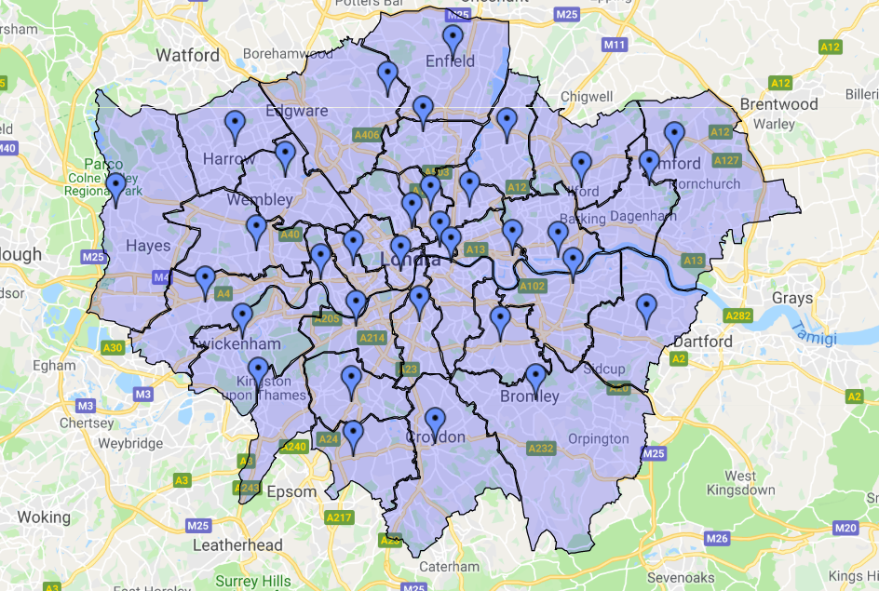
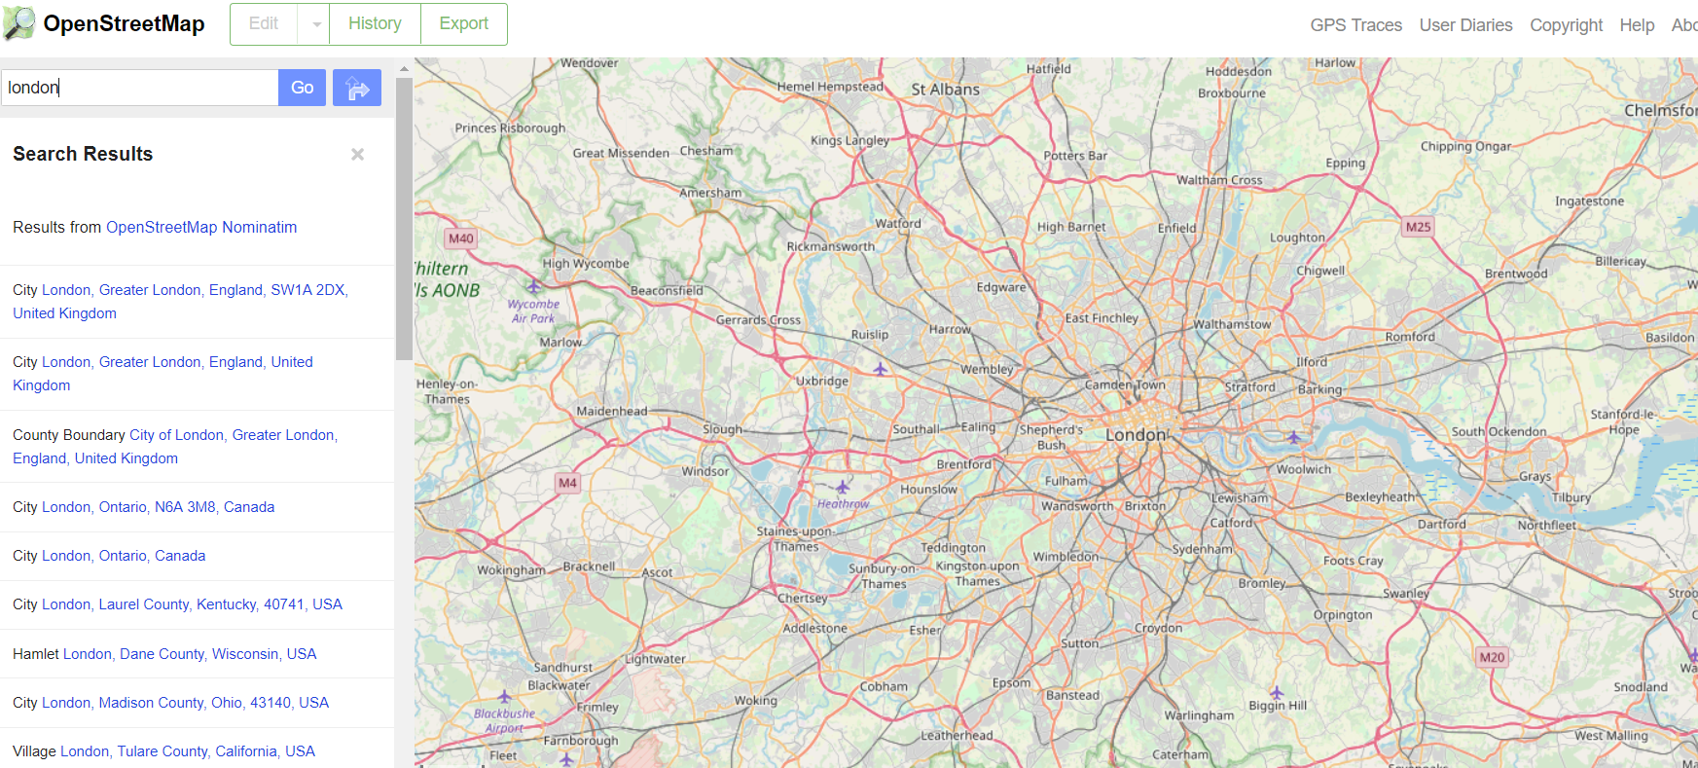
DATA ACQUISITION (1/2)
Sources
Data has been extracted from web scraping in order to have the list of all the borough in London
Fourquare
Open Street Maps
Aim
I extract the list of the 32 London borough and for each of them the the Top Picks. That’s because the new opening must be near to an already famous place so that it can exploit the customers of a known place; also because the Top Picks represent the most visited place and that means a lot of foot traffic in that area. Obviously I have to exclude that borough where the first choice for people is already a food business, in this case, that zone has already a too strong competitor and must be excluded by the analysis. The remaining Borough are 25.

Slide 5

The battle of borough

Slide 6
Data acquisition (2/2)
Assumption
The statistics and I have decided the radius within which Top Picks customers are willing to move to reach another point of interest (our business).
The distance did not have to be excessive to make people give up, so the concept is that the closer to the Top Picks the spot is, the better it is. However, the maximum limit was set at a range of 300 meters.
Characterizing factors
With the remaining borough (25), I studied all the characterizing factors show in the graph on the left

Slide 7
Analysis
Methodology
Once that all the information are collected, a single table is created, in which each area receives a positive or negative score and the sum of the scores will give an overall valuation of the area
Weight calculation
About the analysis on competitors the mark's value is equal to the number of competitors, this mark is then multiply by 2 if the rating is over 7.
About the analysis on the profitability of the area the mark's value is equal to the volume of the positive characteristic found*1,5.
The idea is that the negative mark given to that areas could be balanced by a positive mark given to the borough; in other words, if the location is full of competitors but there is a good foot traffic given by the presence of touristic sight, underground or parking; there can be enough client basin to give a good market share for our business

Slide 8
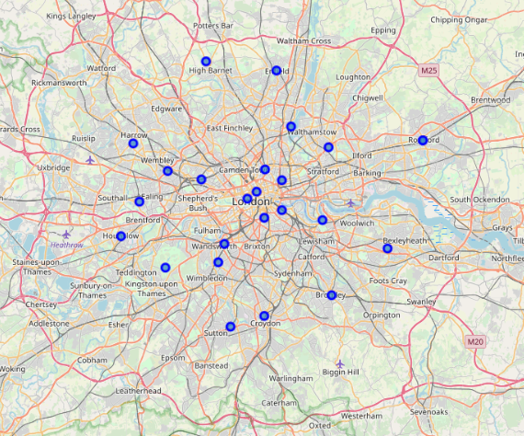
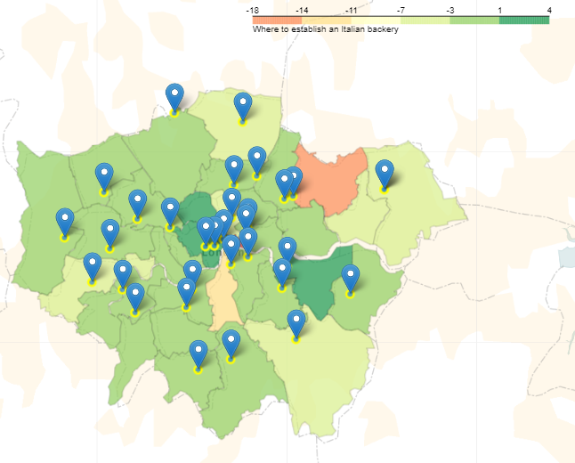
The analysis starting point: the top picks of each borough, in other words the areas of greatest interest in each district.
The analysis end point: a choropleth maps that shows the final valuation on all the boroughs.

Slide 9
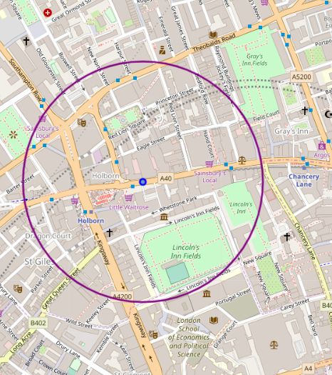
In conclusion the area with the highest assessment is Camden with a final mark of 4, so the best location for our new opening business is in a radius of 300 metres maximum from the Camden Top Pick like is showed in the picture on the right

